Slide 1

SVD for face recognition
Evgenii Plyusch, Evgenii Stepanov
BSE181

Slide 2
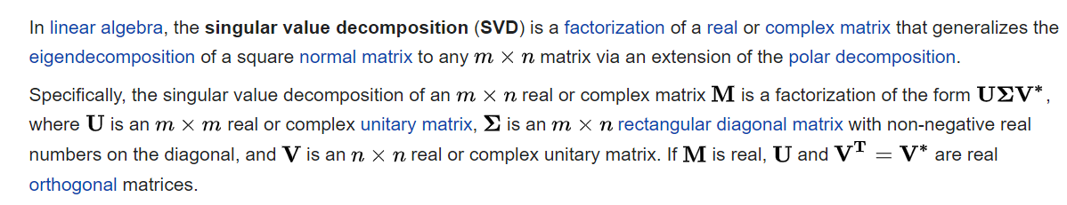
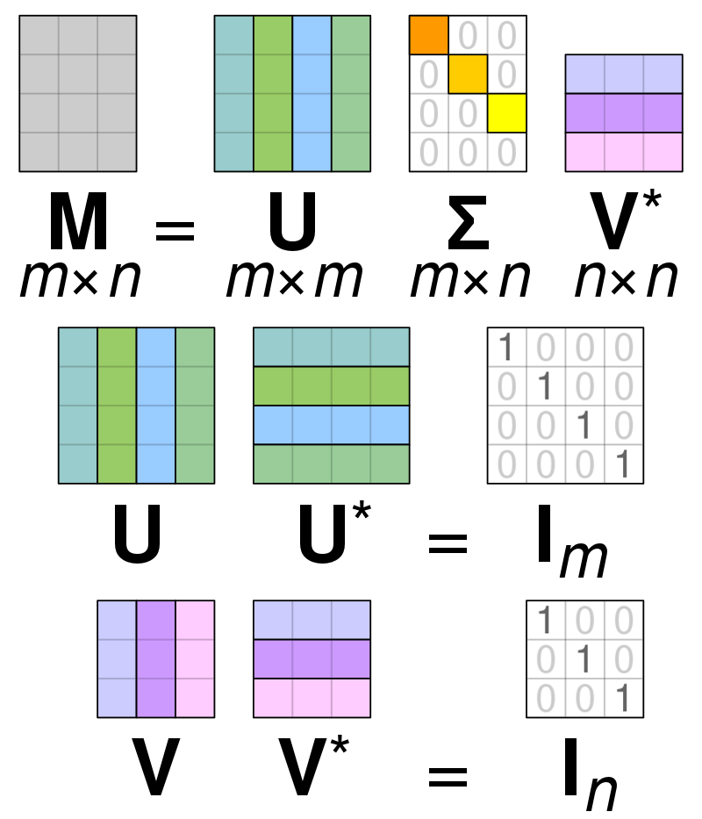

SVD - ?
WHAT IS IT? Just to remind

Slide 3
Our tasks:
1) Make our own implementation of SVD
2) Test it on some small examples
3) Apply SVD to face recognition problem
4) See what will change if we modify (or make zeros) some elements of the $Σ$
4) See what will change if we modify (or make zeros) some elements of the 𝛴

Slide 4
https://github.com/Zhekuson/SVDFaces

Slide 5
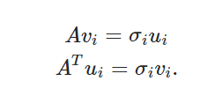
1) Implementation of SVD
Just following our usual algo
We also used some functions from numpy

Slide 6
2) Test our SVD (using np.linalg.svd to check)
Take a look at our demonstration…

Slide 7
3) Face recognition problem
Some experiments (before us, eigenfaces, etc.) showed that one condition should be held: faces on images must be located on the same place and images must be the same size
That’s the reason we take an example ORL Faces dataset (little grayscale images in .pgm format)
We also tried face recognition on different datasets (without holding condition), and later we will show you the results

Slide 8
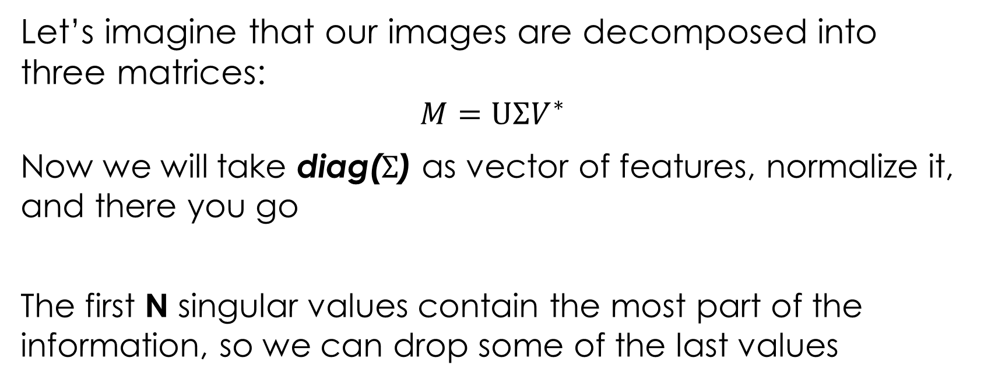
Our hypothesis (👉👈)
Let’s imagine that our images are decomposed into three matrices:
$$M=U{ΣV}^{∗}$$
Now we will take diag($Σ$) as vector of features, normalize it, and there you go
The first N singular values contain the most part of the information, so we can drop some of the last values

Slide 9
Remark: Our method != Eigenfaces
Eigenfaces approach
Our approach
Projections on several subspaces, more data to store
Also, not easy to implement
Save only sigma vector values (several of them) = low memory use
Several lines of code using 2 packages

Slide 10
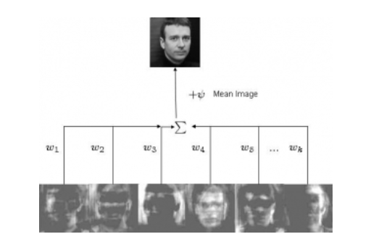
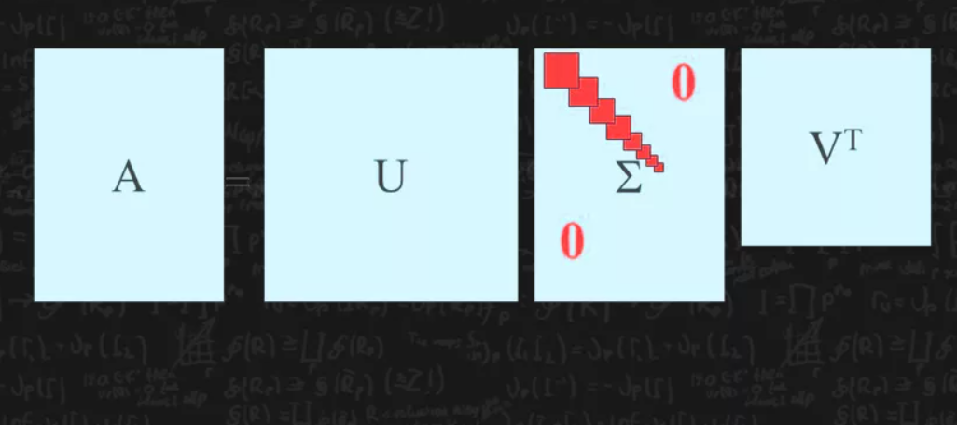

Slide 11
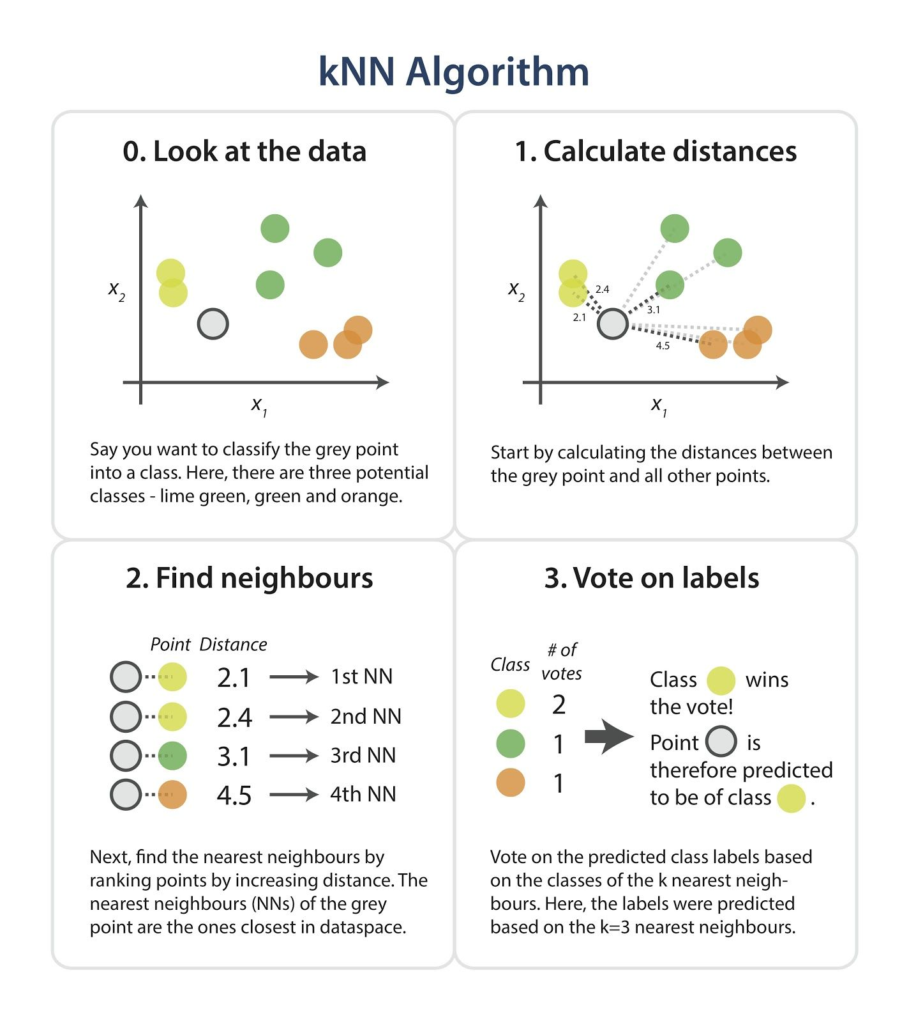
KNN classifier

Slide 12
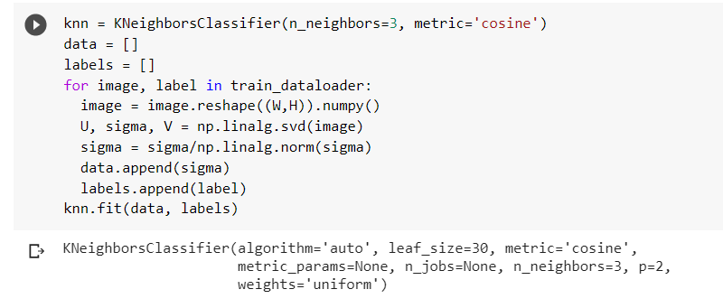
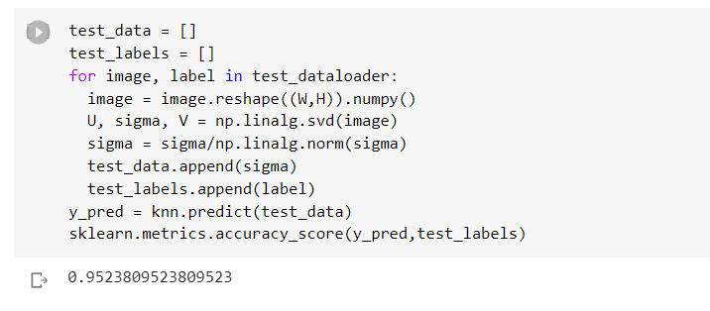
Experiment results
ACCURACY 0.95
Woah!

Slide 13
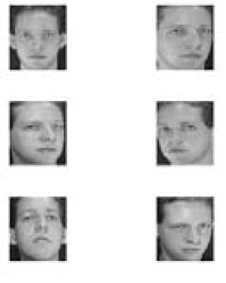
Actually, that was not full ORL
7 classes
21 test images
49 train images

Slide 14
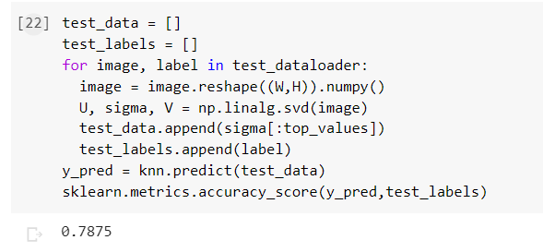
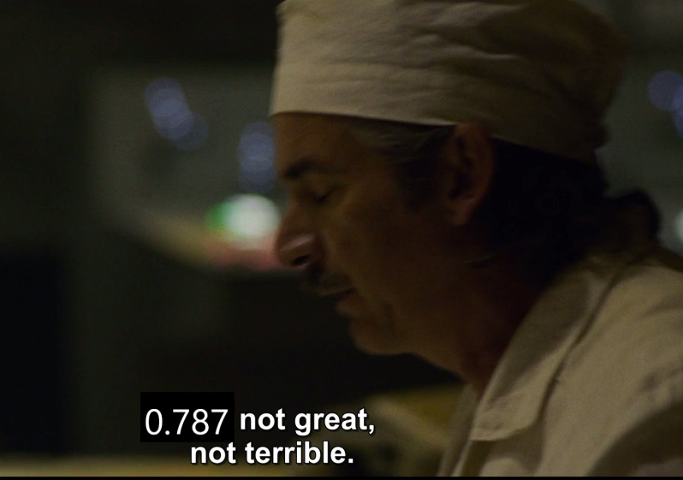
Now with full ORL

Slide 15
And what about other datasets?

Slide 16
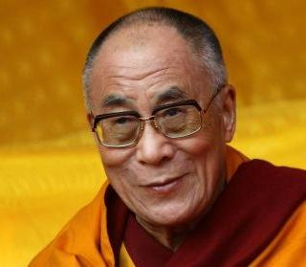
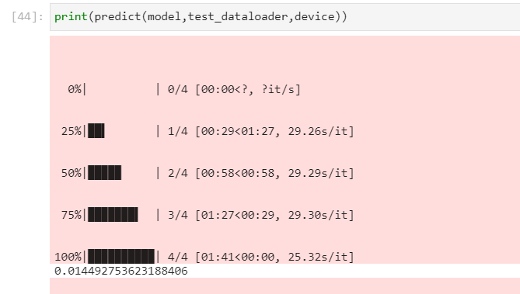
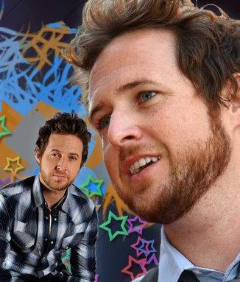
Dataset vgg_face2(little part)

Slide 17
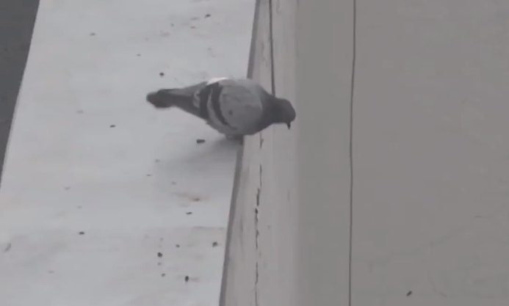
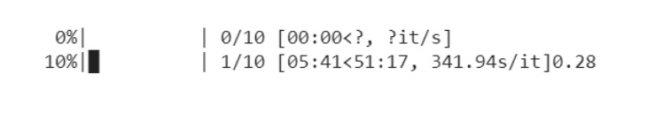
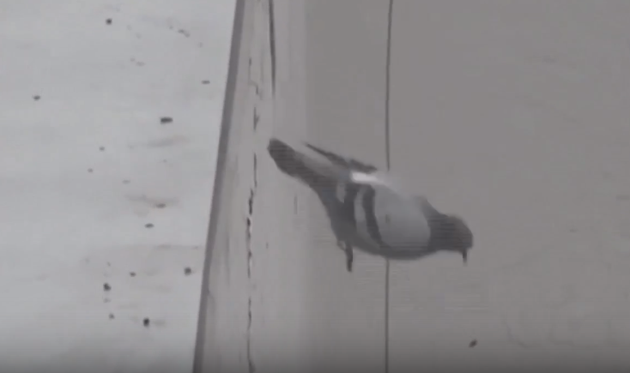

FULL vgg_face2

Slide 18
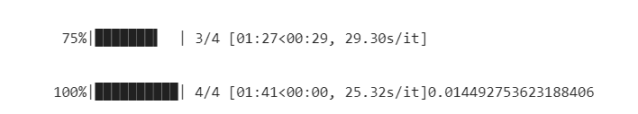

Also, linear models, etc.

Slide 19
Summary
Our approach only works on images with same size and same face location
But on these images definitely works great (so cheap to store data and easy to implement)

Slide 20
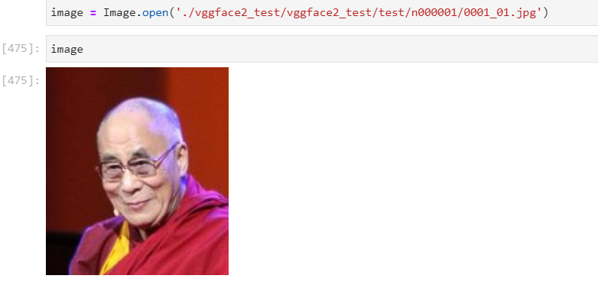
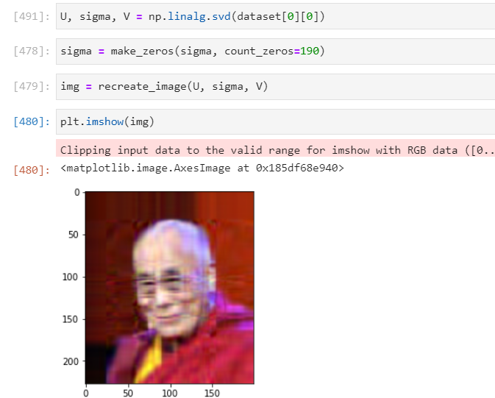
4) Let’s play with eigenvalues

Slide 21
Let’s play with eigenvalues
Put some zeros, starting from the end of sigma matrix
Let’s call count of zeros as “zeros_count”

Slide 22
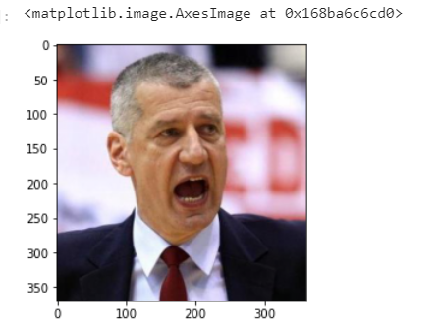
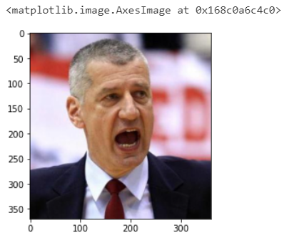
Compare and see
zeros_count = 0 of 365
zeros_count = 200 of 365

Slide 23
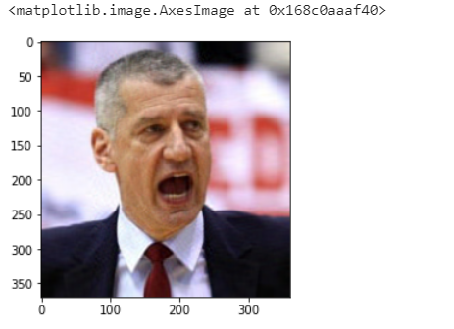
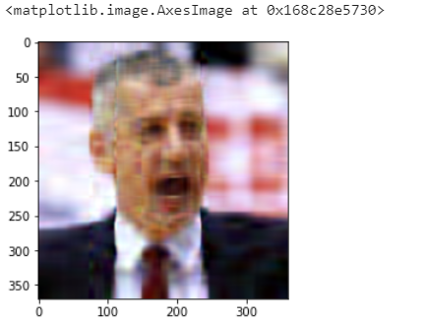
Compare and see
zeros_count = 320 of 365
zeros_count = 340 of 365

Slide 24
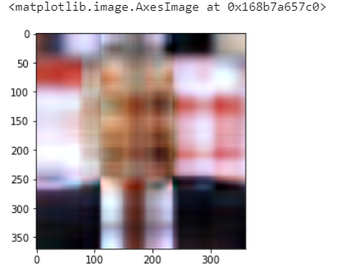
zeros_count = 357 of 365

Slide 25
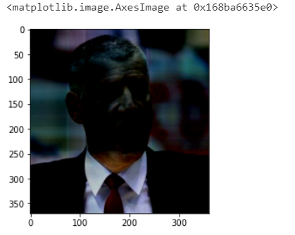
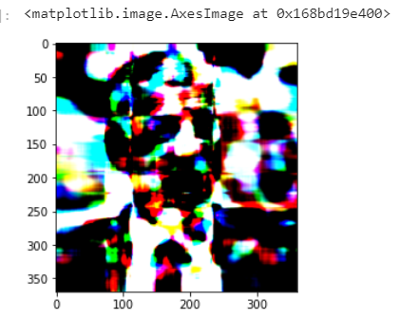
What about changing values?
Changed first singular value to 10 in all channels
Changed first singular value to 1000 in all channels

Slide 26
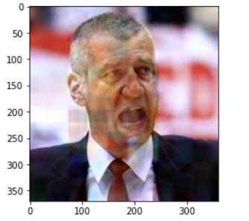
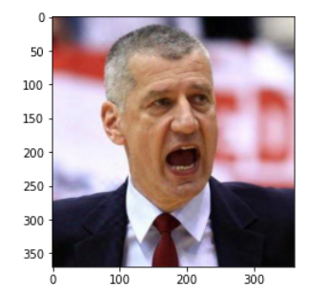
What about changing values?
Changed 5th value to 10
Changed 25th value to 10

Slide 27
Summary
The most important values are located in the beginning of sigma
We can truncate up to 90% of singular values and image still will be recognizable

Slide 28
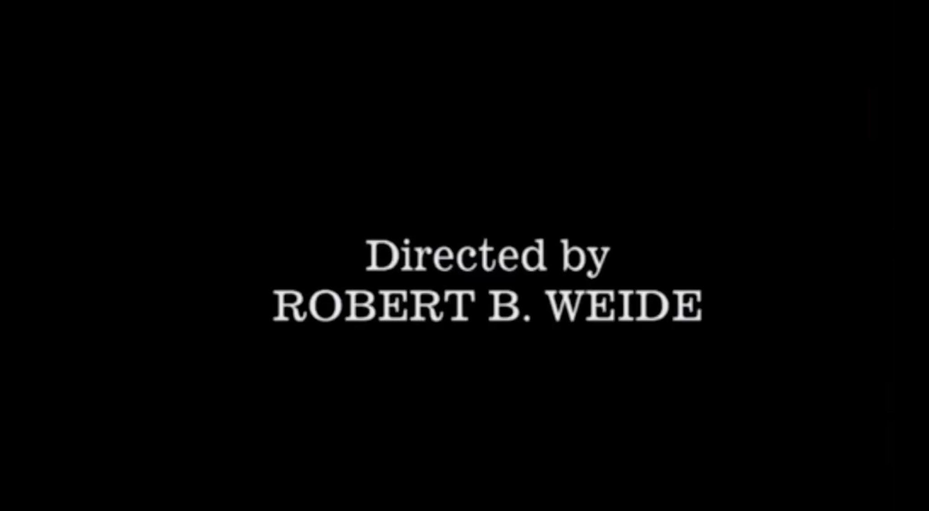
Seems we came to the end… Thanks for your attention!

